Slide 1
Docker Tutorial
February 6, 2025
Real-Time Operating Systems Laboratory,
Department of Electrical and Computer Engineering,
Seoul National University

Slide 2
Contents
Docker Tutorial
Introduction to Docker
Basic Commands for Docker
Running a Docker Image
Building a Docker Image
Sharing a Docker Image
Assignments

Slide 3



Container
I. Introduction to Docker
Definition
An isolated, lightweight instance (environment, context) that contains the application and its dependencies
Essence
A process that runs in independent file systems and execution spaces, created with the host OS's virtualization features
Container
Feature of Container
Containers are easy to move:
“Build once, run everywhere”

Slide 4
Docker (1)
I. Introduction to Docker
An open-source platform designed for packaging, deploying and running applications inside of containers
Platform that makes container easy to use

Slide 5
Docker (2)
I. Introduction to Docker
Architecture
Docker client
Docker daemon
Docker objects
Docker images
Docker containers
Docker registries

Slide 6
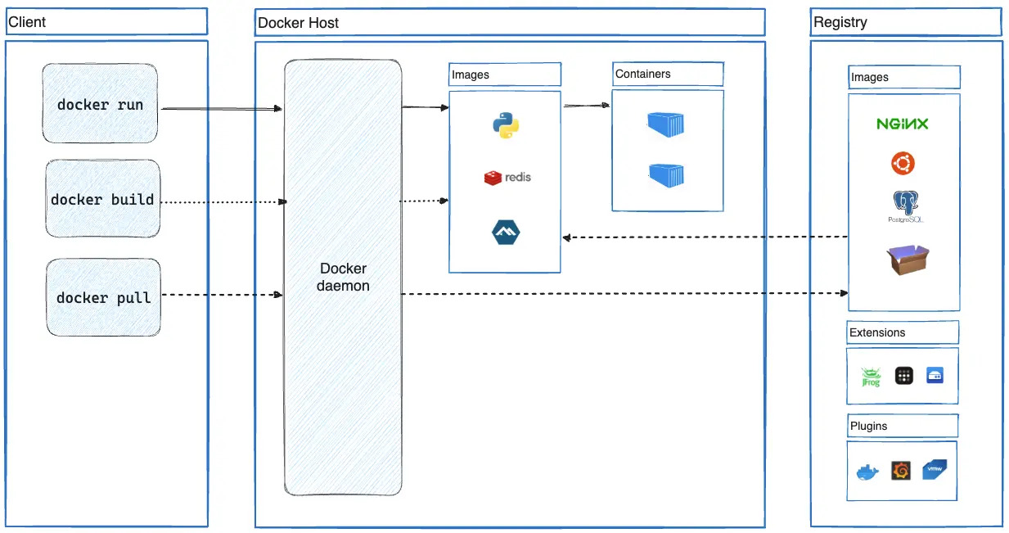
Docker (3)
I. Introduction to Docker

Slide 7
Docker Image vs Docker Container
I. Introduction to Docker
Docker image
A lightweight, standalone, executable package of software that includes everything needed to run an application
A read-only template that is used to build containers
Made by text-based document called Dockerfile
Docker container
A runnable instance of an image
Isolated from the host system and runs with its own filesystem and network
Relationship between Docker image and container
Docker image : Docker container = Executable : Process

Slide 8
Running a Docker Image (1)
II. Basic commands for Docker
Command
docker run [OPTIONS] IMAGE[:TAG|@DIGEST] [COMMAND] [ARG...]
Option | Description
--rm | Automatically remove the container and its associated anonymous volumes when it exits
-d, --detach | Run container in background and print container ID
-i, --interactive | Keep STDIN open even if not attached
-t, --tty | Allocate a pseudo-TTY
-p, --publish | Publish a container's port(s) to the host

Slide 9
Running a Docker Image (2)
II. Basic commands for Docker
Examples
docker run --rm hello-world
docker run --rm ubuntu
docker run --rm ubuntu:20.04
docker run -it --rm ubuntu
docker run -p 81:80 nginx
docker run -d -p 81:80 nginx
docker run --rm ubuntu /bin/bash

Slide 10
Building a Docker Image (1)
II. Basic commands for Docker
Dockerfile
A text-based document that's used to create a container image
Provide instructions to the Docker daemon commands to run, files to copy, startup command

Slide 11
Building a Docker Image (2)
II. Basic commands for Docker
Dockerfile syntax
Instruction | Description
FROM | Create a new build stage from a base image
COPY | Copy files and directories
RUN | Execute commands
CMD | Specify the default commands that a container using this image will run
ENTRYPOINT | Specify the executable that a container using this image will run
ENV | Set environment variables
EXPOSE | Describe which ports your application is listening on

Slide 12
Building a Docker Image (3)
II. Basic commands for Docker
FROM ubuntu:22.04
RUN apt update
RUN apt install build-essential -y
CMD [ "gcc", "-v" ]

Slide 13
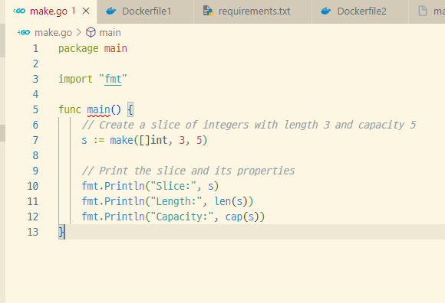
Building a Docker Image (4)
II. Basic commands for Docker
FROM golang
COPY make.go make.go
RUN go build make.go
ENTRYPOINT [“./make"]

Slide 14
Building a Docker Image (5)
II. Basic commands for Docker
Command
docker build [OPTIONS] PATH
docker build .
docker build -t myimage:1 -f Dockerfile .
[-t name:tag] is used to distinguish different versions within the same imgage
After building the Docker image, you can run it using docker run
docker run --rm myimage:1

Slide 15
Sharing a Docker Image (1)
II. Basic commands for Docker
Docker registry
A centralized location for storing and sharing container images
Registry vs Repository
A registry is a centralized location that stores and manages container images, whereas a repository is a collection of related container images within a registry

Slide 16
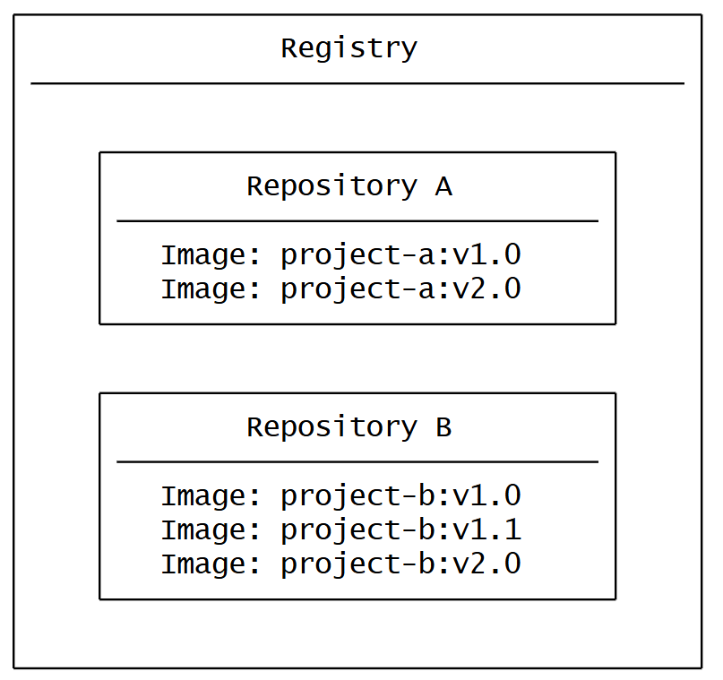
Sharing a Docker Image (2)
II. Basic commands for Docker

Slide 17
Sharing a Docker Image (3)
II. Basic commands for Docker
Commands
docker login
docker push NAME[:TAG]
docker push ssoonan0770/myimage:1
docker pull NAME[:TAG]
docker pull ssoonan0770/myimage:1

Slide 18
Assignments
III. Assignments
Practice docker commands
docker run, docker build, docker push & pull
Create a Dockerfile that compiles and runs the server.c file from the previous assignment
Push the created Docker image to your personal Docker Hub registries

